Slide 1
Unsupervised Learning – Point Clustering
UIUC ECON 490: Applied Machine Learning in Econoimcs

Slide 2
Unsupervised Learning
Where did the y-variable go?
“Unlabeled data”
Applications
Density estimation
Estimate pdf underlying Data
Anomaly detection
What if I say I am not like the others? (Foo Fighters - The Pretender)
Clustering
Why can’t we be friends?
Customer segmentation

Slide 3
Two Methods
K-Means Clustering
Find K groups among data
Choice
Number of clusters
Hierarchical Clustering
Each data own cluster
Hierarchically fuse
Choices
Dissimilarity measure
Linkage

Slide 4
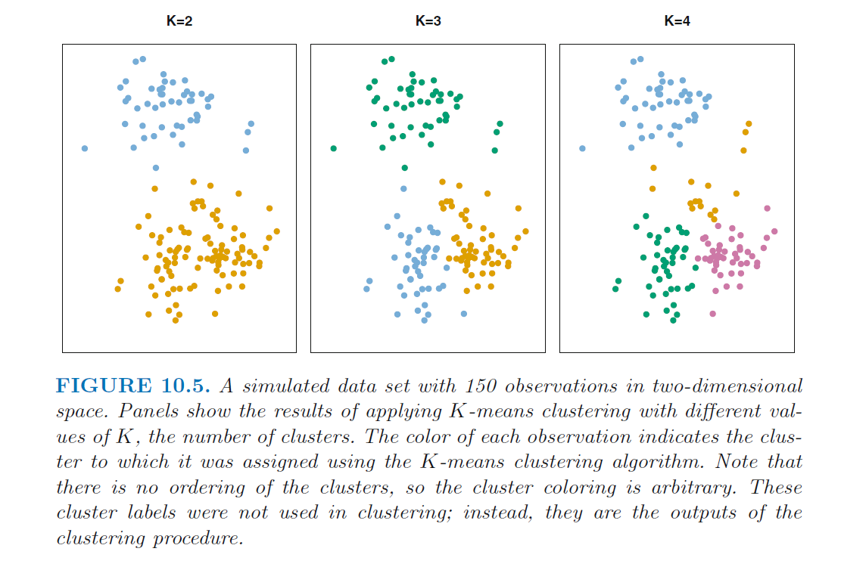
K Means

Slide 5
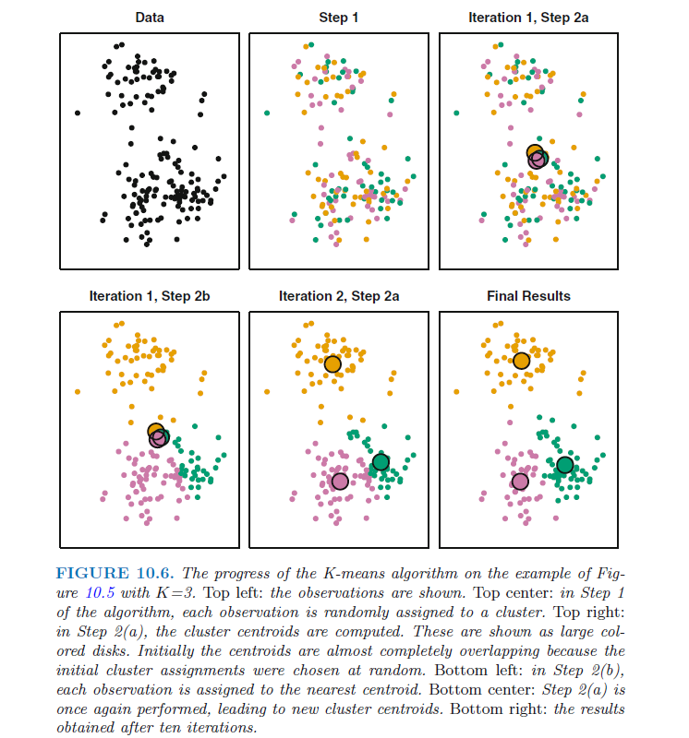
K Means

Slide 6
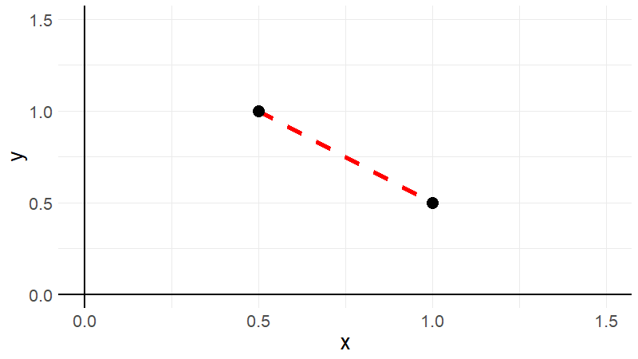
Euclidean Distance (extend Pythagorean Theorem)

Slide 7
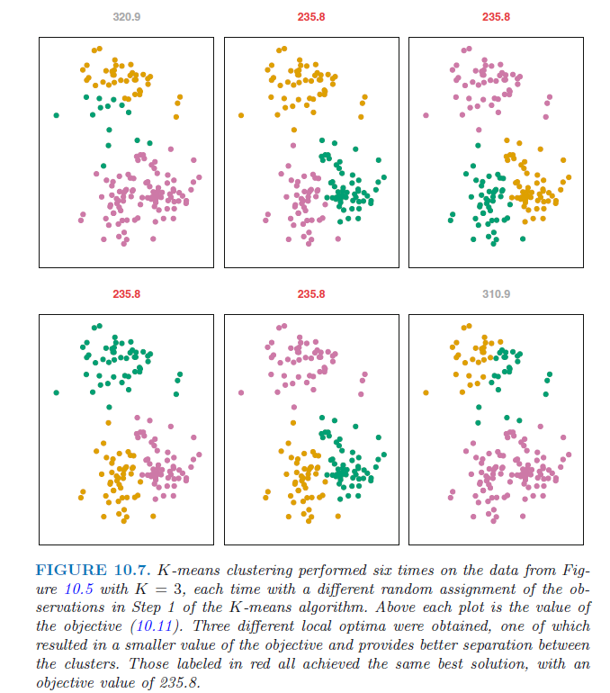
K Means

Slide 8
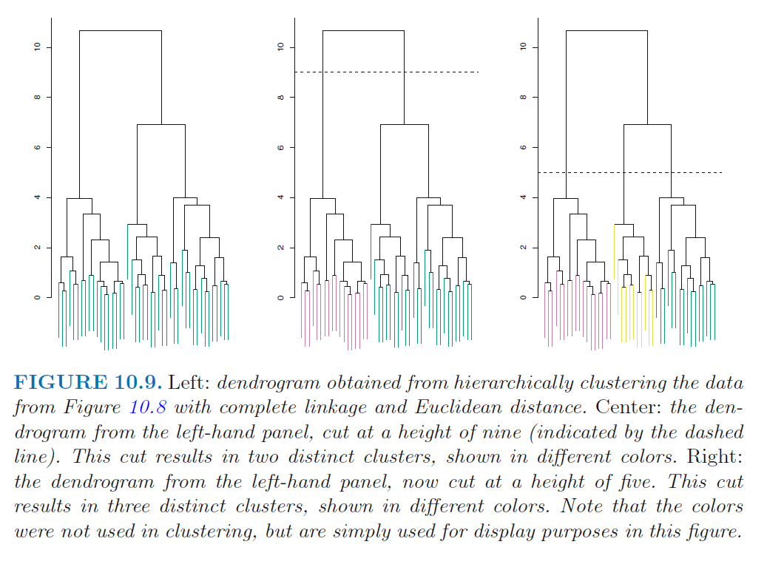
H Clust

Slide 9
H Clust – Dissimilarity Measure
Setting: Online retailer, purchases, and recommendations
Encode purchases 0 or 1
Euclidean distance
Infrequent shoppers encoded together
“Sparse” data
Correlation
Correlation-based Distance

Slide 10
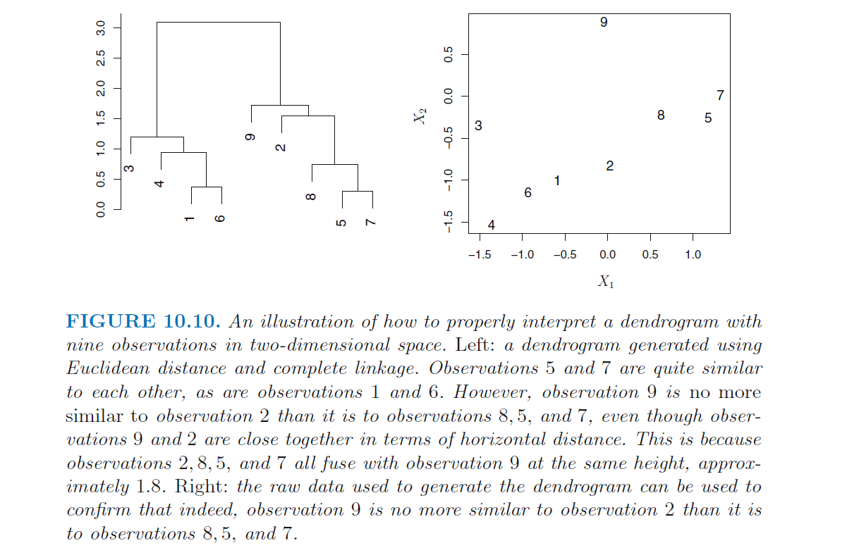
H Clust

Slide 11
Linkages
Complete (Maximal)
Compute all dissimilarities between points in A and B
Record largest
Fuse by smallest of the largest distances
Single (Minimal)
Complete but record smallest
Trailing clusters (see next image)
Average
Pretty self explanatory
Centroid
Calculate centroids of clusters
WARNING can result with defusing (boom!)

Slide 12
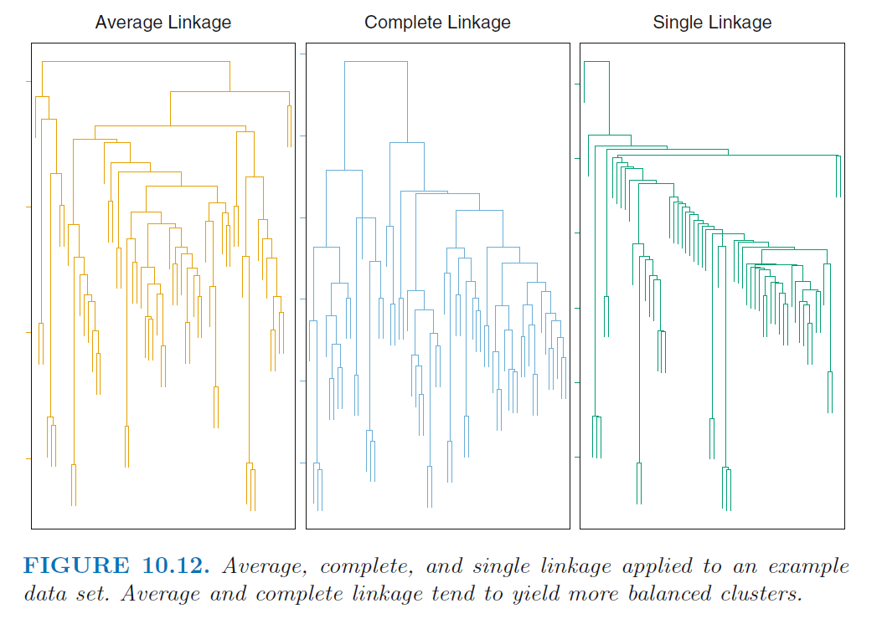
H Clust

Slide 13
Considerations
Scaling matters
Clusters are sensitive to modelling choices
K-means and h-cluster label all data
Soft k-means
“Mixture models” (not covered)
Never know true labels

